Slide 1
Generative AI Literacy for Business Executives

Slide 2

Introduction
Welcome to our Generative AI workshop, specifically designed for business executives. This workshop aims to help you effectively apply Generative AI within your specific domains and industries, enhancing client relationships by creating value for your clients, growing your revenue and optimizing the delivery.
During this workshop, you will gain insight into the evolution of Gen AI, its key concepts, and its ubiquitous impact across industries. You’ll explore Generative AI’s business implications, potential risks, and opportunities, analyze real-world use cases across various sectors, gain practical insights into the Gen AI Applications through interactive hands-on activities and a capstone project. The workshop will deepen your technical understanding, covering a range of Gen AI models, tools, deployment strategies, data engineering and model security, bias mitigation, and ethical considerations.
Upon completing this workshop, you will be equipped to craft strategic business cases for Gen AI for any sector or business model. This knowledge will empower you to guide your clients in leveraging Generative AI effectively, addressing their unique challenges, and aligning solutions with their specific business objectives.
We are dedicated to delivering a workshop that not only provides practical skills but also fosters a dynamic and engaging learning environment.
Ashwin Bharath
Founder, Revature
Notes:
https://www.mckinsey.com/capabilities/mckinsey-digital/our-insights/the-economic-potential-of-generative-ai-the-next-productivity-frontier#introduction
https://bankingblog.accenture.com/how-banks-scale-generative-ai-for-growth
https://www.statista.com/statistics/1334826/ai-in-healthcare-market-size-worldwide/

Slide 3


1
Introduction to Generative AI
2
Impact of AI
3
Discussion: Wins and Losses with GenAI
Agenda
4
Business Implications of Gen AI along with Risks and Challenges
5
Prompt Engineering Exercise: Business Use Cases
6
Take Home Discussion Questions

Slide 4
Introduction to Generative AI

Slide 5

What is GenAI?
5

Slide 6

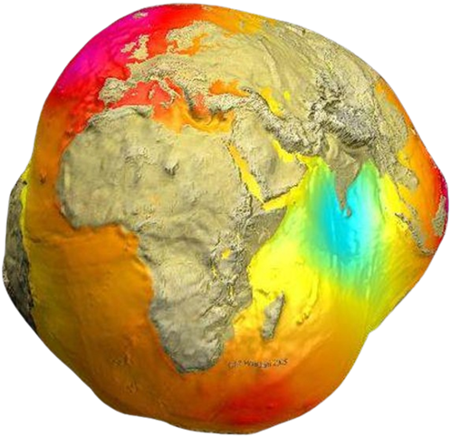
What is real?

Slide 7


What is real?

Slide 8


What is real?

Slide 9



Let's meet the real AI !!!

Slide 10




Average Cognitive assimilation rate
Internet
GenAI
60 bits/sec
Information at your fingertips
Expertise at your Fingertips
What the heck is GenAI?
Trillion bits/sec
Humans learn things
Payback Time
AI learns Humans
Technology to benefit less skilled
Smart Phone
Computer at your fingertips

Slide 11



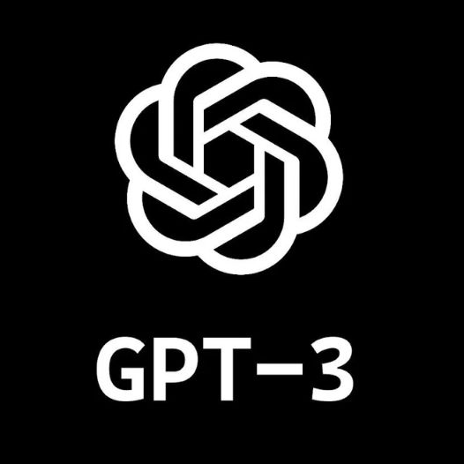

2007
. . . . . .
2022
2023
Apple iPhone
Apple iPhone 14 Pro
TFT Screen
LTPO Super Retina XDR OLED Screen
2 MP Main Camera
48 MP Main Camera
~1400 mAh Battery
~4300 mAh Battery
GSM Network
5G Network
30-Pin Proprietary USB 2.0 Connector
Lightning USB 2.0 Connector
Apple iPhone 15 Pro
LTPO Super Retina XDR OLED Screen
48 MP Main Camera
~4300 mAh Battery
GPT 3
GPT 4
5G Network
175 billion parameters
~1 trillion parameters
Imagine the Future!!!
Type-C USB 3.2 Gen 2 Connector
Trained on 17 gigabytes of data
Trained on 45 gigabytes of data
Can only process text inputs
Multimodal, it can use image inputs
Unsupervised learning mode
Supervised learning model
Bar exam with 10% score
Cleared Bar exam with 90% score

Slide 12
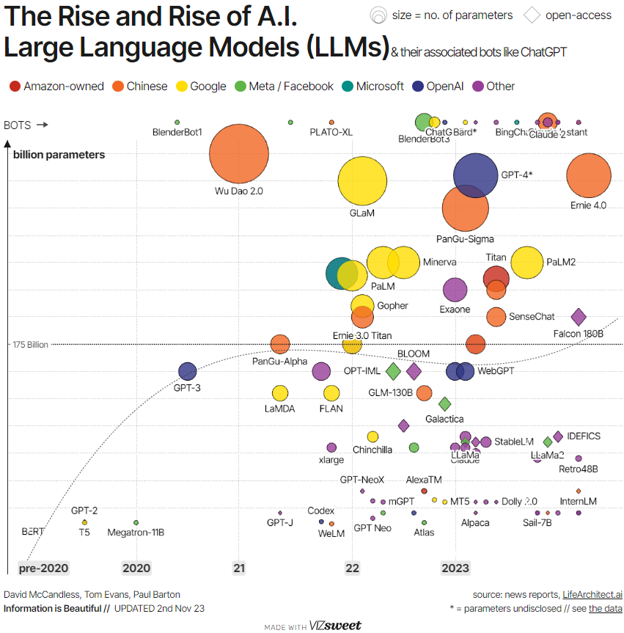
Evolution of AI
Is AI the Next Paradigm?
2023
OpenAI introduced ChatGPT, marking a significant milestone in generative AI
2018
IBM's Watson won Jeopardy!, demonstrating advanced AI language processing and problem-solving capabilities
2011
Smartphones
Ubiquitous Access to computing and internet
2006
IBM's Deep Blue defeated world chess champion Garry Kasparov
1997
Computing
Zero marginal cost of computation
1977
Alan Turing proposed the “Turing Test”
1950
Disruptive Innovation
AI Journey - Milestone
Notes:
Talk about AI Winter

Slide 13
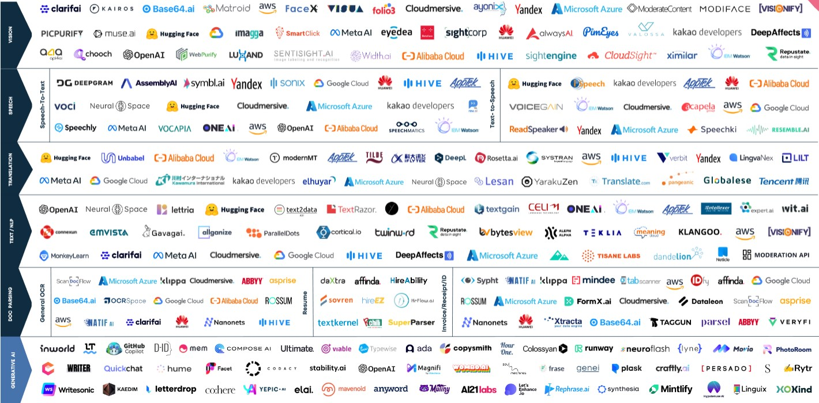
Artificial Intelligence APIs Landscape

Slide 14

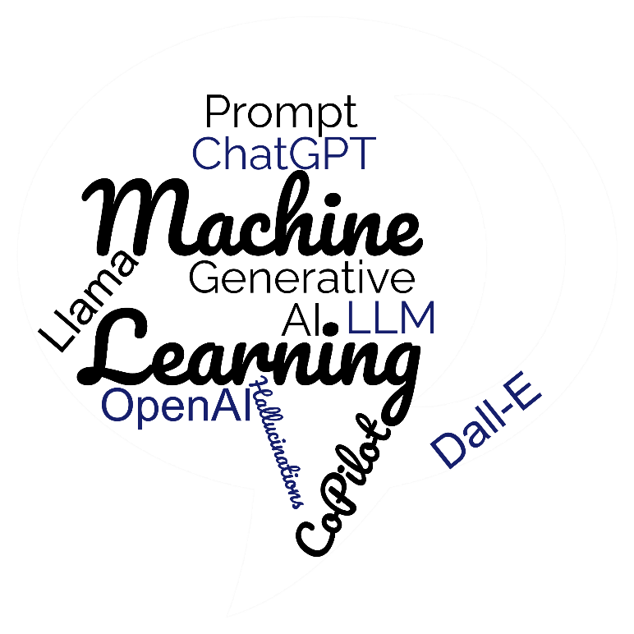
Key Concepts and Terminologies
Term
Meaning
Other Example
ChatGPT
ChatGPT is a chatbot developed by OpenAI. It uses AI and NLP to generate human like responses to questions and word prompts
Google Bard , Bing with ChatGPT, Huggingchat
OpenAI
OpenAI is an AI research and deployment company. Their product include Dall-E, ChatGPT
Jasper, Github
LLM
Large Language Models - programs that undergo training using an extensive collection of text and code, including books, articles, websites, and code snippets
OpenAI – GPT 4, DALL-E, Cohere, LLaMA from Meta, Anthropic’s Claude, Mosaic ML
Models
Refers to the AI system that has been trained to understand and generate new data based on the patterns it has learned from its input training data
Supervised Learning Model, Un-Supervised Learning Model, Reinforcement Learning model
Prompt
Refers to the input or instruction given to the model to generate a specific response. A prompt may be a text description, an image, or even samples of desired audio or video
E.g.,: Prompt: "Write a java program to determine a string is palindrome?”
Hallucinations
Hallucination refers to outputs generated by AI systems that are entirely fabricated rather than grounded in reality
For instance, a text generator hallucinates fictional events as fact
Fine Tune
Fine-tuning is a technique in which pre-trained models are customized to perform specific tasks or behaviors
Few-Shot Learning Method
GPT
Generative Pre-trained Transformer, GPT is an open source large language model used by a number of different AI product companies
Google Bard, Google’s AI chatbot, powered by LaMDA, Chinchilla AI
RAG and FLAG
Retrieval Augmented Generation and Feedback Loop Around GPT
NA

Slide 15

Intro and Market Overview
Gen AI – Industries Impacting
$2.6T-$4.4T
Consumer & Retail
Energy, Resources, and Industrial (ER&I)
Financial Services (FSI)
Government & Public Services (GPS)
Life Sciences & Health Care (LSHC)
Technology, Media, and Telecommunications (TMT)
Generative AI could annually contribute $2.6 trillion to $4.4 trillion
7%
Est. Generative AI impact on Global GDP
Share of companies having fully implemented at least one AI use case in their production (today) or plan to (further) implement AI in the near future (ambition) across industries. Image: BCG
75%
of value that Gen AI Use cases falls across four areas
Customer Operations
Marketing & Sales
Software Engineering
R&D
Notes:
Here's how generative AI can transform industrial operations | World Economic Forum (weforum.org)
https://www.mckinsey.com/capabilities/mckinsey-digital/our-insights/the-economic-potential-of-generative-ai-the-next-productivity-frontier#key-insights
Generative AI Use Cases for Industries and Enterprises (gartner.com)
https://www2.deloitte.com/content/dam/Deloitte/us/Documents/consulting/us-ai-institute-gen-ai-use-cases.pdf
https://www.weforum.org/agenda/2023/05/jobs-lost-created-ai-gpt/
https://www.weforum.org/agenda/2023/05/jobs-lost-created-ai-gpt/

Slide 16






Opportunities in Industries
Retail and CPG
Financial Services
Healthcare & Life Sciences
Media & Entertainment
Manufacturing
Communication Service Providers
Creative Assistance
Financial Document Search & Synthesis
Digital Patient Concierge
Media Content Discovery
Machine Generated Events Monitoring
Customer/Employee Service Automation
Conversational Commerce
Enhanced Virtual Assistant
Public & Private Contextual Search
Creative Assistance
Customer Service Automation
Network Planning & Operations¹
Customer Service Automation
Capital Markets Research
Expedite Prior Authorization Letter
Internal Document/ Media Search
Document Search & Synthesis
Advertising & Content/Creative Assistance
New Product Development
Regulatory Code Change Consultant
Clinical Trial Report Generation
Branded Consumer Interactions
Product/Content Catalog Discovery
Employee Knowledge Search
Improving Employee Productivity
Personalized Financial Recommendations
Customer Service Agent
Content Summarization and Metadata
Supply Chain Advisor
Test/Code Script Generation
Supply Chain Advisor
Contract Analysis & Negotiation
1. Network Planning & operations use cases include Network Capacity Planning, Network Root Cause Analysis, and Post Mortem Creation

Slide 17



AI – Adoption Across Industries
I think AI can level the playing field from a service perspective relative to hotels because hotels have front desk, Airbnb doesn’t
Brian Chesky, Co-founder and CEO of Airbnb
High
Low
Value Potential of the function for the industry
About 75 percent of the value that generative AI use cases could deliver falls across four areas: Customer operations, marketing and sales, software engineering, and R&D
Generative AI is going to rapidly become part of our daily lives if it isn't already, and we need to determine how to embrace it in a safe and secure way
Lisa Heneghan, Global Chief Digital Officer, KPMG
Industry | Product R&D, Software Engineering | Customer Operations | Marketing & Sales | Others
Telecom | Legacy Code Conversion Cloud Native Migration | Customer IVR | Marketing and Customer Offers | Risk model documentation
Retail and Consumer Goods | Consumer Research | Augmented Customer Support | Copy Writing/ Marketing Content Creation | Procurement Supplier Process
Pharma | Research and drug discovery | Customer Document Generation | Content for Commercial Representatives | Contract Generation
Wipro to spend $1 billion on improving its artificial intelligence capabilities over the next three years, including training its entire staff of 250,000 people across 66 countries
Thierry Delaporte, Former CEO, Wipro
Source: The Economic Potential of generative AI, McKinsey & Co, June 2023
17

Slide 18































GenAI Architecture
Reference Implementation
LLM Apps
Agent Workbench
Development, Orchestration, Observability
Model Hub
Inference Providers
Hyperscalers
Open Source
Intelligence (LLMs)
Memory (Vector Database)
Compute & GPUs
Closed Source
Open Source

Slide 19





Knowledge Base
Enterprise RAG
Knowledge Engine
Enterprise RAG Architecture Realization
Vectorize
Routing
Retrieve
Prompt Library
Generate Response
Ranking
Caching
Members
LLMs
Vector Database
Vectorization & Indexing Pipeline
Sources
Vectorize
Chunk

Slide 20



Productivity Agents
Lead Generation
Agent Workbench
LLMs
Agent Interface
Lead Generation Agent
Customer service Agent
Vector Database
Business Intelligence Agent
IT Support Agent
Software Dev Agent
HR support Agent
Enterprise Tools
“AI Agents – the future of enterprise productivity & automation”

Slide 21
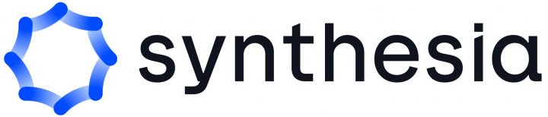















Generative AI – Basic Components
Application Layer
Specific domains and use cases that leverage generative AI to create new content or solve problems..
Orchestration
Abstraction layer that manages the interactions and coordination of multiple systems, applications, and services.
Databases
Adapting and specializing pre-trained models to specific domains or tasks using additional data or information
Fine Tuning
Adapting and specializing pre-trained models to specific domains or tasks using additional data or information
Foundational Models/LLM
Programs that undergo training using an extensive collection of text and code, including books, articles, websites, and code snippets
Infrastructure components
Hardware and software resources that enable the training and deployment of generative AI models.

Slide 22
Emerging GenAI Approach Pattern
Training models with domain data
Building your own Model
Finetuning with domain data
Customization/Differentiation
Instruction based Finetuning
Finetuned LLM Models
Retrieval Augmented Generation (RAG)
Prompt Engineering
In-context Learning LLM models
* Qualitative comparison and not drawn to scale
Complexity/Cost, Data Management Scale/Complexity
Notes:
Ashwin – Gen AI Literacy

Slide 23
Impact of Generative AI

Slide 24
Core Value Creation Using Generative AI right now
Summarize massive amounts of information and draw insights
Automating code creation, suggesting improvements, and aiding in debugging
Summarize and extract insights from unstructured data sources
Efficient information retrieval
Assistive problem-solving
Interpret, translate, and generate code (e.g., legacy systems migration, test automation, documentation)
Synthetic data generation
Application prototyping
Concision
Coding
User service chatbots
Infographics, videos or text to explain complex concepts
Co-pilot enabled personalized experience
Customer service available 24/7 through intelligent chatbots
Continuous product improvements from customer insights
Customer Engagement
Creative Content
Creation of e.g., contracts, NDAs, etc. to reduce manual work
Create personalized communication, design, and next-product-to-buy recommendations (e.g., outbound marketing, emails, website content)

Slide 25
The development and distribution of platforms and foundation models for Generative AI is becoming more accessible and widespread; the overall Generative AI stack is also becoming more mature and robust
The size of foundation models is not the only factor that matters; it is also important to find the optimal model that balances the cost and performance for the task
The customization and tuning of models is getting easier with the availability of open models that can be adapted and modified for different purposes
The emergence of custom silicon and accelerators is creating a significant improvement in the economics of Generative AI, making it more affordable and efficient
The early adopters of Generative AI have an advantage in differentiating themselves, especially if they have access to proprietary data that can enhance their models
Additional points to note

Slide 26


Before we proceed to next module, let’s answer the most important questions…
“Will AI take over humans?”
“The true sign of intelligence is not knowledge but imagination”
Carriages were the main transportation for 3000 years before Automobile were introduced
Albert Einstein

Slide 27
Generative AI deployment plans by industry
When will you organization begin deploying generative AI technologies (apart from isolated experiments)?
Leaders: We have already deployed at least one use case
Leaders: We are already formally experimenting
All industries
IT & telecom
Financial services
Professional services
All industries
Professional services
IT & telecom
Consumer goods & retail
Financial services
9%
28%
17%
15%
9%
18%
14%
13%
13%
Laggards: Not yet deployed or experimenting
All industries
Transport & logistics
Energy & utilities
Pharma & health care
Travel & hospitality
Government
81%
96%
95%
90%
89%
88%
Source: MIT Technology Review Insights poll, 2023
Notes:
(https://www.telstra.com.sg/en/campaigns/generative-ai-differentiating-disruptors-from-the-disrupted)

Slide 28






Impact in BFSI
Potential Productivity Lift
3-5%
Fraud Detection
Legacy Code Conversion
Risk Model Documentation
Detect anomalies or unusual behavior
Detection of real-time frauds
Adversarial Learning
Coding Patterns
Privacy-Preserving Machine Learning
create masks for sensitive data
of Global Industry Revenue
From 2.8 to 4.7 percent of annual revenues across Banking
Portfolio Management
Credit Risk Assessment
Scenario Analysis
~$200B-$340B
of Global Industry Revenue
Loan Decision Making
Customer IVR
Marketing and Customer Offers
90%
Automate the loan underwriting process
Faster Decision-Making
Predictive Analytics
Enhanced Customer Intelligence
Efficient Interpretation of Customer Intent
Building Meaningful Customer Relationships
Hyper-personalized content
Accelerate marketing processes
of all working hours in the banking industry can be impacted by large language models (LLMs)
Source: McKinsey The economic potential of generative AI
28
Notes:
https://www.mckinsey.com/capabilities/mckinsey-digital/our-insights/the-economic-potential-of-generative-ai-the-next-productivity-frontier#business-value

Slide 29





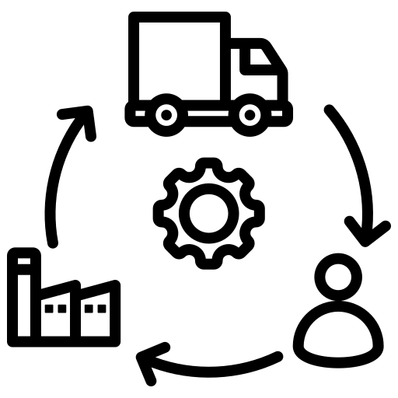
Impact in Retail Industry
Potential Productivity Lift
1-2%
Augmented Customer Support
Marketing Content Creation
Digital Commerce
Product Recommendation
Content Creation
of Global Industry Revenue
From 1.2 to 2 percent of annual revenues across Retail
Chatbots
Automatic Translation
Marketing Campaigns
Product Design
Product description
~$400B-$660B
of Global Industry Revenue
IT and Core Applications
Consumer Research
Procurement Supply Process
21%
Faster Software Development
Increasing Productivity
Market research and Trends
Data Analysis and Insights
Freight Tracking
Supply Chain Optimizations
of worldwide retailers and brands are already investing in the implementation of GenAI technologies.
29

Slide 30






Impact in Healthcare Industry
Potential Productivity Lift
3-5%
Technology
Drugs Manufacturing
Customer Document Generation
Reduce cost and downtime by Automated Code generation
Customer-Facing Chatbots
Accelerated Drug Designing
Drug Screening
Generative Product Design
Optimizing Trials and Process
of Global Industry Revenue
From 2.6 to 4.5 percent of annual revenues across the pharmaceutical and medical-product industries
Synthetic-data generation
Data Sharing and Interoperability
Generative AI Cloud Services
~$60B-$110B
of Global Industry Revenue
Research &Drug Discovery
Content for Commercial Representatives
Contract Generation
~$1.7B
Risk Mitigation
Automated Contract Templates
Customized Contract Language
Accelerated Drug Discovery, Clinical planning and execution
Precision medicine therapies
Patient Screening and On-demand personal Care
Real time data Integration
Automation of claim processing
venture capital firms have invested over $1.7 billion in generative AI solutions over the last three years, with AI-enabled drug discovery and AI software coding receiving the most funding.
Source: McKinsey The economic potential of generative AI
30
Notes:
https://www.mckinsey.com/capabilities/mckinsey-digital/our-insights/the-economic-potential-of-generative-ai-the-next-productivity-frontier#business-value

Slide 31



Activity: Gen AI Wins and Losses
Consider the experience you’ve had, if any, with GenAI. You can also consider the experiences of your peers and collogues, if needed.
Wins Using GenAI
Have you successfully used GenAI to achieve your business goals?
How were processes made more efficient?
Losses Using GenAI
Has there been a GenAI project where GenAI turned out not to be the right choice?
Have there been missed opportunities where GenAI could have improved a business process?
Neither
Have there been any conversations with the client that have not going forward or backward – if so, why?

Slide 32

Opportunity Prospects – for Consulting and SI firms
Innovation
Productivity based vs Location Arbitrage impacting ~28 Million Software Developer Roles. Opportunities to have more AI enabled programmers
Opportunities within ~11 Mn Shared Services Jobs by creating AI Empowered Techno Functional Experts
Value based pricing models instead of traditional T&M, FP
Emerging Horizons
AI Enabled Workforce in IT and ITES (Developers, Testers, Analysts and various functional roles)
Projects including COE Setup, POCs, Point Solutions leveraging AI
New Roles powered by AI: Prompt Engineers, AI Compliance Managers, AI Integration experts etc
Quick Wins
Training and Consulting on AI and impact of AI
AI Enabled workforce
Cost Optimization

Slide 33
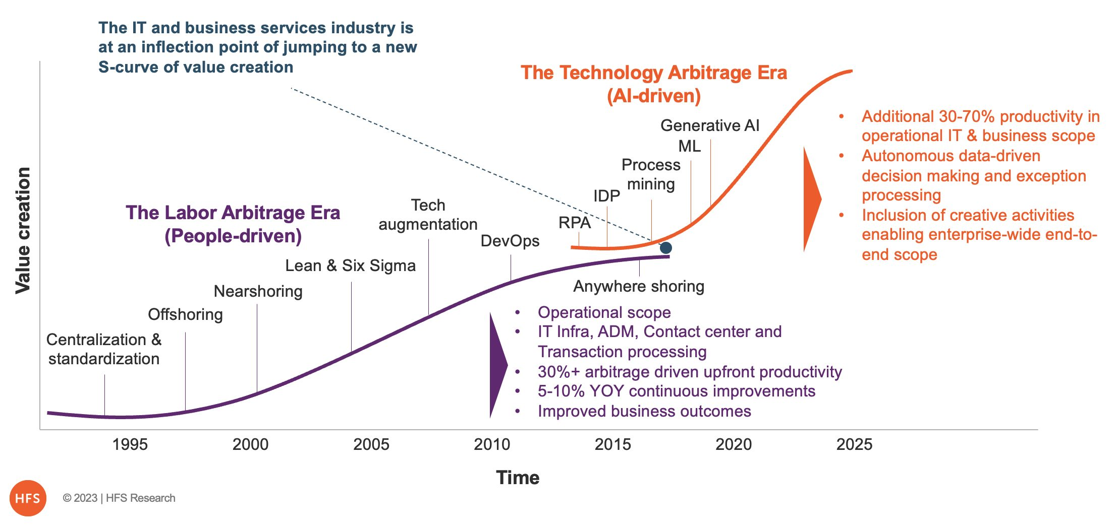
The Era of Technology Arbitrage has begun
The Technology Arbitrage era is not only about doing more with less but also generating actionable business value
Source: HFS Research
Notes:
Fannie Mae never had the benefit of Labor Arbitrage…
For the first time you have a even playing field now with Technology Arbitrage.
Leftshift is happening and this is going to be great for Fannie Mae
https://www.horsesforsources.com/forget-labor-arbitrage_111823/

Slide 34






AI – Impact on Workforce
Low
High
Impact of AI
19% of the workforce have 50% of the work tasks impacted by LLMs
80% of the workforce have 10% of the work tasks impacted by LLMs
Zone 1*
Zone 2
Zone 3
Zone 4
Zone 5
Preparation required: None or little (0-3 Months)
Education: High School Diploma
Experience: Little or none
Preparation required: Some (3-12 months)
Education: High School Diploma
Experience: Some
Preparation required: Medium (1-2 Years)
Education: Vocational/ related on-the-job experience/ associate's degree.
Experience: Moderate
Preparation required: Considerable (2-4 Years)
Education: Four-year bachelor's degree
Experience: Significant
Preparation required: Extensive (4+ Years)
Education: Graduate/ Master's / Ph.D., e
Experience: Extensive. Many require 5+ years of experience
Landscaping Workers
Laundry and Dry-Cleaning Workers
Food Preparation Workers
Data Entry Keyers / Bank Tellers
Customer Service Representatives
Administrative Assistants
Web Developers
Computer User Support Specialists
Desktop Publishers
Database Administrators
Software Developers
Data Scientists
Research Scientists
Biostatisticians
Environmental Economists
Some job attributes that defines impact of AI
Low Impact | High Impact
Labor Intensive People Management Critical Thinking | Content Related – text, Images, Multimedia Programming Creative Thinking
Most impacted IT role – 28 Mn+ Software Developers Worldwide
*The zone definition is from O*NET
Notes:
Zone 2 to 5 description needs to be added from o*net website

Slide 35

AI is going to trigger an upward mobility & Create additional Roles
Zone 1
Zone 2
Zone 3
Zone 4
Zone 5
11 Mn+ Shared Services Jobs would be disrupted by the upward mobility and heterogeneous and wider skills
Credit Authorizers, Checkers, and Clerks (Zone 2)
Qualification: high school+ diploma
Experience(IT): Limited
Technical Knowhow: Limited
Business Intelligence Analysts/Computer Programmer
(Zone 4)
AI + Upskilling
Bank Tellers (Zone 2)
Qualification: High School + Diploma
Experience(IT): None
Technical Knowhow: Limited
AI + Upskilling
Entry level software Engineer (Zone 4)
Prompt Engineers
AI Code Testers
Citizen Developers
AI Content Strategist
AI Integration Lead
AI Ethics & Governance
AI Architect
AI Security Specialist
New roles introduced by AI
Zone 3
Zone 4
Zone 5

Slide 36
Occupational Transition and Displacement
Skills
We expect an additional 12 million occupational transitions through 2030
US job growth, index (0=2016 levels)
40
Resilient and growing occupations
30
Zone 2
+17% 9.9M jobs
20
Stalled but rising occupations
10
+7% 2.8M jobs
Zone 3
0
-10
2016
2019
2022
2030
Short Learning curve
De-Skill

Slide 37
Gen AI maturity still low across industries, TMT companies in North America ahead of the curve
Gen AI maturity (overall)
Industry
Asia
Europe
North America
<25
Don't fully understand Gen AI, discourage its use
25 to <50
Experimenting with Gen AI, no policies in place
50+
See Gen AI as value source setting up guardrails
Source: BCG Digital Acceleration Index (DAI)-Global Study 2023; n=270
Notes:
Ashwin – Gen AI Literacy

Slide 38



Insecure code generation
Legal and regulatory
Risks and Challenges
Data privacy/ IP
Ethics and reputation
Threat actor evolution
Notes:
<a href="https://www.freepik.com/free-photo/digital-circle-circuit-blue-background-futuristic-technology_17122185.htm#query=Hacking&position=3&from_view=search&track=sph">Image by rawpixel.com</a> on Freepik

Slide 39
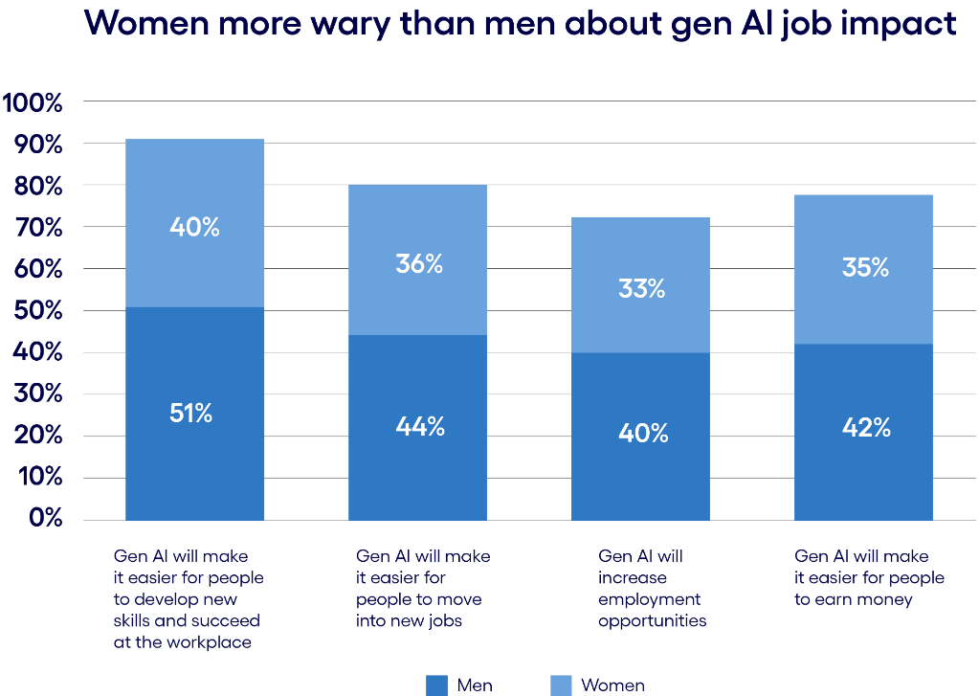
Women are nervous about GenAI than Men …..
AI impact on Women Jobs
Women
Blue-Collar
30%
70%
White-Collar
3.5 million jobs currently
GenAI Transformation
2 million jobs with higher productivity
New jobs (11.8 million) with better pay and additional skills
*Percentage of Women in the role as compared to Men

Slide 40

Power consumption
Average human burns about ~2000 calories a day, equivalent to the energy needed to power a 100-watt bulb
Human brain is 10²⁰ times more energy-efficient than modern computers.
Counting 10²⁰ will take a million years to complete
Similarly, a hummingbird burns just 7 calories a day
Both examples highlight how natural efficiency far surpasses our most advanced technology and the need for efficiency in computing power
Confidential and Property of Revature
40

Slide 41
Gen AI contribution to NetZero
Aid in Policy and Regulation through Simulation
Data Analysis and Predictive Modeling
Innovative Solutions including Gamification
Automation and Efficiency
Awareness and Education on Sustainability
Climate Monitoring and Risk Management
Behavioral Insights and Engagement
Reporting and Governance

Slide 42
Tech Stack vs Workforce
Computing
Systems
Application
3*
17
80
Trends
Microsoft investing 100B in data center
Computing
Systems
Applications
Software
?
?
?
?
*Proportion of talent in each layer

Slide 43
Generative AI implementation challenges
What are the primary challenges your organization faces in successfully implementing generative AI?
Source: MIT Technology Review Insights poll, 2023

Slide 44
Regulatory and governance challenges by industry
What are the primary challenges your organization faces in successfully implementing GenAI?
Source: MIT Technology Review Insights poll, 2023

Slide 45
Limitations & Challenges
1
Bias & Fairness
01
Addressing bias in training data is a crucial challenge for fair and unbiased AI applications
2
Safety & Security
02
There is a risk of malicious or accidental misuse of generative AI, which can lead to safety and security concerns
3
Ethical Considerations
Clear ethical guidelines and responsible deployment are essential to mitigate misuse
03
4
Data Quality and Control
04
AI output quality relies on accurate and diverse training data. Unpredictable or undesirable outputs pose challenges in result control.
5
Computational Requirements
Generative AI can be computationally expensive and time-consuming, which might limit its use in resource-constrained environments
05
06
6
Data Privacy
7
Dynamic Environments
Models may inadvertently memorize sensitive information present in the training data, leading to privacy concerns
Real-world scenarios often involve unpredictable factors that can challenge the adaptability of models
07

Slide 46
Capabilities require attention to scale GenAI adoption at the enterprise level
What it will take
Common Challenges
Strategy roadmap
Clear view of most impactful GenAI use cases
Top-team alignment on opportunities
Unclear view of high impact areas
Pilots without clear roadmap to scale
A
Strategy
A
Technology & partnership
Modern tech stack (GPU enabled, distributed computing)
Data science capability in deep learning, neural networks, probabilistic models to handle large-scale data
MLOps capabilities to reduce risk & model improvement
Limited adoption of required infra (e.g., cloud) and access to tools/API (e.g., OpenAI)
B
B
C
D
E
Techno-logy
Data
Operating model
Talent
Data
Proprietary data to fine-tune FMs
Strong data management strategy
Unavailability of unstructured data sources on data science environment
C
Operating model
Experimentation based approach – “move fast break things”
Redesign business processes & resource deployment
Lack of ownership among employees in transition from traditional roles
D
Talent
ML Ops/ML capabilities to fine-tune models
Experienced infrastructure team to setup and maintain systems to host and train large models
Limited availability of experts in GenAI for driving innovation
E
Risks & Governance
F
Risk & Governance
Dedicated risk function or responsible AI team
Defined guardrails and audit on responsible use
Clarity on technology risk and risk mitigation strategies
Unclear understanding of AI guidelines
F
G
Adoption & Change Management
Adoption & change management
Plan for organization wide skill building & cultural change
Lack of sponsorship from leaders
G
Notes:
Ashwin – McKinsey

Slide 47


Slide 48
How to spell Success for the next few years?
Disruption!

Slide 49

Greater than the tread of mighty armies is an idea whose time has come
Confidential and Property of Revature
Victor Hugo
49

Slide 50
Gen AI Business Use Case: Insurance - Underwriting - Generated by LLM
The Problem Statement
Underwriting in the insurance sector requires evaluating potential risks to determine appropriate coverage levels and premiums. This traditionally labor-intensive process involves analyzing vast amounts of data, including historical claims, customer information, and external factors. The manual nature of underwriting can result in inefficiencies, inconsistencies, and delays, impacting decision-making quality and customer satisfaction. Implementing a Generative AI solution could streamline this process by automating data analysis, enhancing accuracy, and improving overall efficiency and customer experience.
Current Business Process
Generative AI Solution
1. Data Collection: Underwriters gather data from various sources, including historical claims, customer profiles, and external factors such as economic indicators and environmental conditions.
2. Risk Assessment: Underwriters manually analyze the collected data to identify risk factors and determine the likelihood of claims.
3. Risk Profiling: Based on the risk assessment, underwriters create risk profiles for potential policyholders.
4. Coverage Recommendation: Underwriters recommend appropriate coverage levels and premiums based on the risk profiles.
5. Approval and Documentation: The recommended coverage is reviewed, approved, and documented in the system.
Generative AI can revolutionize the underwriting process by automating data analysis and risk profiling, leading to more accurate and faster decision-making. The proposed solution involves the following steps:
1. Automated Data Ingestion: Generative AI can automatically collect and integrate data from various sources, including historical claims, customer information, and external factors.
2. Advanced Risk Analysis: AI algorithms can analyze the data to identify patterns and correlations that may not be evident to human underwriters.
3. Dynamic Risk Profiling: Generative AI can generate detailed risk profiles by considering a broader range of factors and continuously updating them as new data becomes available.
4. Coverage Recommendation: AI can recommend appropriate coverage levels and premiums based on the generated risk profiles, ensuring consistency and accuracy.
5. Continuous Learning and Improvement: The AI system can learn from new data and feedback, continuously improving its risk assessment and recommendation capabilities.
Source: Appian getting started for Gen AI for Insurance

Slide 51
Gen AI Business Use Case: Insurance - Underwriting - Generated by LLM
Comparison of the Generative AI Solution with the Existing Approach
Plan to Integrate the Solution with the Existing System
Phase 1: Proof of Concept (3 months)
- Identify key data sources and integrate them into a data lake.
- Develop and train initial AI models for risk analysis and profiling.
- Test the AI models with historical data to validate accuracy and effectiveness.
Phase 2: Pilot Deployment (6 months)
- Deploy the AI system in a controlled environment with a select group of underwriters.
- Collect feedback and refine the AI models and user interface.
- Ensure seamless integration with existing underwriting systems.
Phase 3: Full Deployment (9 months)
- Roll out the AI system across the entire underwriting department.
- Provide training and support to underwriters for effective use of the new system.
- Continuously monitor performance and make necessary adjustments.
Phase 4: Continuous Improvement (Ongoing)
- Regularly update the AI models with new data and feedback.
- Explore additional use cases and enhancements to further improve underwriting efficiency.
Operational Efficiency: Generative AI can process and analyze data much faster than human underwriters, reducing the time required for risk assessment and profiling.
Time Consumption: The AI-driven process can significantly cut down the time taken from data collection to coverage recommendation, allowing underwriters to focus on more complex cases.
Cost Efficiency: By automating repetitive and time-consuming tasks, generative AI can reduce operational costs and improve productivity. Fewer resources are needed for manual data analysis and risk assessment.
Accuracy and Consistency: AI algorithms can analyze vast amounts of data with high precision, leading to more accurate and consistent risk profiles and coverage recommendations.
Source: Appian getting started for Gen AI for Insurance

Slide 52
Gen AI Business Use Case: Insurance – Claim Processing - Generated by LLM
The Problem Statement
The insurance industry faces significant challenges in claims processing and fraud detection. The traditional approach is labor-intensive, time-consuming, and prone to human error, leading to inefficiencies and increased operational costs. Additionally, the detection of fraudulent claims is complex, often resulting in financial losses and reputational damage. Generative AI offers a promising solution to streamline the claims process by automating document assessment, extracting relevant information, summarizing claims histories, and identifying inconsistencies or fraudulent claims based on data patterns and anomalies.
Current Business Process
Generative AI Solution
Claims Submission: Policyholders submit claims through various channels, including online portals, email, and physical documents.
Initial Review: Claims are manually reviewed by claims adjusters to verify completeness and accuracy.
Document Assessment: Relevant information is extracted from claims documents, which is a time-consuming and error-prone process.
Claims History Analysis: Adjusters manually review the claimant's history to identify any patterns or inconsistencies.
Fraud Detection: Specialized teams use rule-based systems and manual checks to identify potential fraud, which is often inefficient and limited in scope.
Claims Approval/Denial: Based on the assessment, claims are either approved, denied, or sent for further investigation.
Payment Processing: Approved claims are processed for payment, while denied claims may lead to disputes and further reviews.
Automated Document Assessment:
Use Generative AI models to automatically extract relevant information from claims documents, reducing manual effort and errors.
Implement Optical Character Recognition (OCR) combined with Natural Language Processing (NLP) to handle various document formats and languages.
Claims History Summarization:
Utilize AI algorithms to summarize the claimant's history, highlighting key events and patterns that may indicate fraudulent behavior and generate concise reports for claims adjusters to expedite the review process.
Fraud Detection:
Deploy machine learning models trained on historical claims data to identify anomalies and patterns indicative of fraud.
Implement real-time fraud detection systems that flag suspicious claims for further investigation.
Source: Appian getting started for Gen AI for Insurance

Slide 53
Gen AI Business Use Case: Insurance – Claim Processing - Generated by LLM
Comparison of the Generative AI Solution with the Existing Approach
Plan to Integrate the Solution with the Existing System
Operational Efficiency
- Existing Approach: Highly manual, leading to bottlenecks and inefficiencies.
-AI Solution: Automates repetitive tasks, significantly reducing processing time and human intervention.
Time Consumption:
-Existing Approach: Claims processing can take days to weeks due to manual reviews and checks.
- AI Solution: Processes claims in real-time or within hours, accelerating the overall timeline.
Cost Efficiency:
- Existing Approach: High operational costs due to labor-intensive processes and potential fraud losses.
- AI Solution: Reduces labor costs and minimizes fraud-related financial losses, leading to substantial cost savings.
Phase 1: Assessment and Planning:
Conduct a thorough assessment of the existing claims processing system.
Identify key integration points and data flow requirements.
Phase 2: Development and Testing:
Develop and train AI models using historical claims data.
Test the models in a controlled environment to ensure accuracy and reliability.
Phase 3: Pilot Implementation:
Implement the AI solution in a pilot phase with a subset of claims.
Monitor performance and gather feedback for further refinement.
Phase 4: Full-Scale Deployment:
Roll out the AI solution across the entire claims processing system.
Provide training and support to staff for smooth adoption.
Phase 5: Continuous Improvement:
Continuously monitor the system's performance and update models as needed.
Incorporate feedback and new data to enhance the AI solution's accuracy and efficiency.
Source: Appian getting started for Gen AI for Insurance

Slide 54
Gen AI Business Use Case: Supply Chain Management - Generated by LLM
The Problem Statement
In demand forecasting, production planning, and risk management, organizations struggle to analyze extensive data for accurate real-time models. Current methods often fail to optimize inventory, production schedules, and distribution effectively, leading to inefficiencies. Identifying supply chain risks from diverse data lacks proactive strategies. Implementing Generative AI can automate analysis, enhance forecasting accuracy, optimize planning, and enable proactive risk management, improving operational efficiency and decision-making.
Current Business Process
Generative AI Solution
1. Demand Forecasting:
Automated Data Integration: Generative AI can automatically integrate data from multiple sources, including historical sales, market trends, social media sentiment, and economic indicators.
Advanced Predictive Models: Use of advanced machine learning models to predict demand with higher accuracy and adapt to real-time changes.
Outcome: Enhanced forecasting precision, leading to optimized inventory levels and reduced stockouts or overstock situations.
2. Production Planning:
Dynamic Scheduling: AI-driven dynamic scheduling that adjusts production plans in real-time based on demand forecasts and resource availability.
Resource Optimization: Generative AI can optimize resource allocation, ensuring efficient use of labor, machinery, and materials.
Outcome: Improved production efficiency, reduced lead times, and minimized production bottlenecks.
3. Risk Management:
Proactive Risk Identification: Generative AI can analyze diverse data sources to identify potential risks proactively.
Predictive Analytics: Use of predictive analytics to forecast potential disruptions and their impact on the supply chain.
Outcome: Enhanced risk mitigation strategies, leading to reduced supply chain disruptions and improved resilience.
1. Demand Forecasting:
Data Collection: Manual aggregation of historical sales data, market trends, and seasonal factors.
Analysis: Use of basic statistical models and spreadsheets to predict future demand.
Challenges: Limited accuracy, time-consuming processes, and inability to adapt to real-time changes.
2. Production Planning:
Scheduling Manual creation of production schedules based on demand forecasts.
Resource Allocation: Allocation of resources based on static models.
Challenges: Inefficient resource utilization, frequent schedule changes, and production bottlenecks.
3. Risk Management:
Risk Identification: Manual identification of risks based on historical data and expert judgment.
Mitigation Strategies: Reactive strategies to manage identified risks.
Challenges: Inability to predict and mitigate risks proactively, leading to supply chain disruptions.
Source: EY- How supply chains benefit from using Gen AI?

Slide 55
Gen AI Business Use Case: Supply Chain Management - Generated by LLM
Comparison of the Generative AI Solution with the Existing Approach
Plan to Integrate the Solution with the Existing System
Phase 1: Assessment and Planning:
Conduct a thorough assessment of current processes and identify key areas for improvement.
Develop a detailed implementation plan, including timelines, resources, and budget.
Phase 2: Data Preparation:
Collect and clean historical data from various sources.
Set up ETL processes for continuous data integration.
Phase 3: Model Development:
Develop and train machine learning models for demand forecasting, production planning, and risk management.
Validate models using historical data and refine as needed.
Phase 4: Deployment and Integration:
Deploy models on the chosen AI platform.
Integrate AI solutions with existing ERP and SCM systems.
Phase 5: Monitoring and Optimization:
Continuously monitor model performance and make adjustments as needed.
Provide training to staff on using the new AI-driven tools and processes.
1. Operational Efficiency:
Existing Approach: Manual processes are time-consuming and prone to errors.
Generative AI Solution: Automated and accurate processes, leading to significant improvements in operational efficiency.
2. Time Consumption:
Existing Approach: Manual data analysis and planning can take days or weeks.
Generative AI Solution: Real-time data processing and decision-making, drastically reducing time consumption.
3. Cost Efficiency:
Existing Approach: Inefficiencies lead to higher operational costs due to overstock, stockouts, and production delays.
Generative AI Solution: Optimized inventory levels, efficient production schedules, and proactive risk management result in substantial cost savings.
Source: EY- How supply chains benefit from using Gen AI?

Slide 56
Gen AI Business Use Case: Manufacturing - Product Design - Generated by LLM
The Problem Statement
Organizations often face challenges in rapidly generating and evaluating multiple design alternatives based on predefined criteria. Traditional design processes are slow and limit innovation speed, impacting the development of efficient, durable, and aesthetically appealing products. Implementing a Generative AI solution could significantly accelerate the innovation process by quickly producing and assessing hundreds of design options, applicable to everything from machinery parts to consumer products.
Current Business Process
Generative AI Solution
1. Initial Conceptualization: Designers and engineers brainstorm and create initial sketches or CAD models.
2. Prototype Development: Selected designs are developed into physical or digital prototypes.
3. Evaluation: Prototypes are evaluated based on criteria such as functionality, durability, cost, and aesthetics.
4. Iteration: Based on feedback, designs are iterated, often requiring multiple cycles of prototype development and evaluation.
5. Finalization: Once a satisfactory design is achieved, it is finalized for production.
This process is time-consuming, resource-intensive, and often limits the exploration of innovative design alternatives.
Overview: Generative AI leverages machine learning algorithms to generate a wide array of design alternatives based on predefined criteria. It can rapidly produce and evaluate designs, optimizing for factors such as material usage, structural integrity, cost, and aesthetics.
Implementation Steps:
1. Data Collection: Gather historical design data, performance metrics, and evaluation criteria.
2. Model Training: Train the Generative AI model using the collected data to understand design principles and evaluation criteria.
3. Design Generation: Use the trained model to generate hundreds of design alternatives.
4. Automated Evaluation: Implement algorithms to evaluate the generated designs against predefined criteria.
5. Human Review: Designers and engineers review the top-performing designs for final adjustments and approval.
6. Prototype Development: Develop prototypes of the selected designs.
7. Finalization: Finalize the design for production after successful prototyping and testing.
Source: EY- How supply chains benefit from using Gen AI?

Slide 57
Gen AI Business Use Case: Manufacturing - Product Design - Generated by LLM
Comparison of the Generative AI Solution with the Existing Approach
Plan to Integrate the Solution with the Existing System
Operational Efficiency:
Traditional Approach: Relies heavily on manual input and iterative cycles, leading to inefficiencies.
Generative AI: Automates the generation and preliminary evaluation of designs, significantly reducing manual effort.
Time Consumption:
Traditional Approach: Design cycles can take weeks to months due to the iterative nature.
Generative AI: Can produce and evaluate hundreds of designs in a matter of hours or days.
Cost Efficiency:
Traditional Approach: High costs associated with multiple prototype developments and prolonged design cycles.
Generative AI: Reduces costs by minimizing the number of prototypes needed and accelerating the design process.
Phase 1: Assessment: Evaluate the current design process and identify integration points.
Phase 2: Pilot Project: Implement a pilot project to test the Generative AI solution on a small scale.
Phase 3: Feedback Loop: Collect feedback from designers and engineers to refine the solution.
Phase 3: Full Deployment: Gradually scale the solution across the organization, ensuring compatibility with existing systems.
Phase 4: Training and Support: Provide training for staff and establish a support system for ongoing maintenance and updates.
Source: EY- How supply chains benefit from using Gen AI?

Slide 58
Gen AI Business Use Case: Finance - Data Synthesis - Generated by LLM
The Problem Statement
Banks struggle to efficiently analyze and synthesize vast amounts of financial data, limiting their ability to gain valuable insights, make informed decisions, and offer data-driven solutions. Traditional data management methods are often inefficient and time-consuming. Implementing Generative AI for data synthesis can address these challenges by streamlining data interpretation, enhancing decision-making, and improving the quality of data-driven solutions.
Current Business Process
Generative AI Solution
1. Data Integration and Unification: Generative AI can automatically integrate and unify data from various sources, eliminating data silos.
Example: Using AI to merge transactional data with customer profiles and market trends in real-time.
2. Automated Data Cleaning and Preprocessing: Generative AI models can identify and correct anomalies, missing values, and inconsistencies in the data autonomously. Example: AI detecting and rectifying discrepancies in transaction records without human intervention.
3. Advanced Data Synthesis: Generative AI can generate synthetic data to fill gaps, simulate scenarios, and enhance the dataset's richness.
Example: Creating synthetic customer profiles to predict future behaviors and preferences.
4. Real-Time Data Analysis: Generative AI can perform complex analyses in real-time, providing immediate insights.
Example: Real-time fraud detection by analyzing transaction patterns as they occur.
5. Automated Report Generation: Generative AI can generate comprehensive reports and visualizations automatically, reducing time and human error.
Example: AI generating daily financial health reports for executives with actionable insights.
6. Enhanced Decision-Making: Generative AI provides decision-makers with predictive analytics and recommendations, leading to more informed and timely decisions. Example: AI recommending investment strategies based on real-time market analysis and historical data.
1. Data Collection: Banks collect vast amounts of data from various sources, including transaction records, customer profiles, market data, and regulatory reports.
2. Data Storage: This data is stored in disparate databases and data warehouses, often leading to data silos.
3. Data Cleaning and Preprocessing: Data scientists and analysts spend significant time cleaning and preprocessing data to ensure its quality and consistency.
4. Data Analysis: Analysts use traditional statistical methods and business intelligence tools to analyze data. This process is often manual and requires significant expertise.
5. Report Generation: Insights are compiled into reports for decision-makers, which can be time-consuming and prone to human error.
6. Decision-Making: Based on these reports, executives make strategic decisions, often with a lag due to the time taken in data processing and analysis.
Source: Mastercard Generative AI: The Transformation of Banking

Slide 59
Gen AI Business Use Case: Finance - Data Synthesis - Generated by LLM
Comparison of the Generative AI Solution with the Existing Approach
Plan to Integrate the Solution with the Existing System
Phase 1: Assessment and Planning
Conduct a thorough assessment of existing data infrastructure.
Define integration requirements and success metrics.
Phase 2: Pilot Implementation
Implement the Generative AI solution in a controlled environment.
Integrate with existing data sources and storage systems.
Monitor performance and gather feedback.
Phase 3: Full-Scale Deployment
Scale the solution across the organization.
Ensure seamless integration with legacy systems.
Provide training and support to staff.
Phase 4: Continuous Improvement
Continuously monitor and optimize the AI models.
Incorporate feedback and adapt to changing business needs.
Regularly update the technology stack to leverage new advancements.
1. Operational Efficiency:
Existing Approach: Manual, labor-intensive, and prone to errors.
Generative AI Solution: Automated, accurate, and efficient
2. Time Consumption:
Existing Approach: Time-consuming data cleaning, analysis, and report generation
Generative AI Solution: Real-time data processing and instant report generation
3. Cost Efficiency:
Existing Approach: High labor costs and delayed decision-making impacting profitability
Generative AI Solution: Reduced labor costs, faster decision-making, and improved ROI
Source: Mastercard Generative AI: The Transformation of Banking

Slide 60
Gen AI Business Use Case: Finance – Content Creation - Generated by LLM
The Problem Statement
Organizations in the finance sector face significant challenges in producing engaging and personalized content at scale for marketing, customer communication, and reporting. Traditional content creation methods are often time-consuming, resource-intensive, and lack the level of personalization needed to engage modern audiences effectively. These inefficiencies can lead to suboptimal customer experiences, reduced engagement, and missed opportunities for growth and retention.
Current Business Process
Generative AI Solution
1. Marketing Content:
Content Strategy: Developing a content strategy based on market research and customer segmentation.
Content Creation: Writing articles, blog posts, social media updates, and email campaigns manually.
Review and Approval: Multiple rounds of review and approval by various stakeholders.
Distribution: Publishing content across different channels.
2. Customer Communication:
Template-Based Communication: Using pre-defined templates for customer emails, notifications, and alerts.
Manual Customization: Customizing templates manually to address specific customer needs.
Review and Dispatch: Reviewing and sending out communications, often requiring significant human intervention.
3. Reporting:
Data Collection: Gathering data from various sources.
Analysis: Analyzing data manually or using basic tools.
Report Writing: Writing detailed reports manually
Review and Distribution: Reviewing reports and distributing them to stakeholders.
1. AI-Powered Content Generation:
Natural Language Processing (NLP): Utilizing advanced NLP models to generate high-quality, engaging content for marketing, customer communication, and reporting.
Personalization: Leveraging customer data to create personalized content tailored to individual preferences and behaviors.
Automation: Automating repetitive tasks such as content drafting, editing, and formatting.
2. AI-Driven Customer Communication:
Dynamic Templates: Creating dynamic templates that can be automatically populated with personalized content.
Real-Time Customization: Using AI to customize communications in real-time based on customer interactions and feedback.
3. AI-Enhanced Reporting:
Automated Data Analysis: Using AI to analyze large datasets and extract meaningful insights.
Report Generation: Automatically generating detailed reports with visualizations and narratives.
Continuous Improvement: Continuously improving content quality through machine learning algorithms that learn from user feedback and engagement metrics.
Source: Mastercard Generative AI: The Transformation of Banking

Slide 61
Gen AI Business Use Case: Finance – Content Creation - Generated by LLM
Comparison of the Generative AI Solution with the Existing Approach
Plan to Integrate the Solution with the Existing System
Phase 1: Assessment and Planning: Conduct a thorough assessment of existing systems and processes. Develop a detailed implementation plan.
Phase 2: Pilot Phase: Implement the Generative AI solution in a controlled environment to test its effectiveness and gather feedback.
Phase 3: Full-Scale Deployment: Roll out the solution across the organization, ensuring seamless integration with existing systems.
Phase 4: Training and Support: Provide training to employees on using the new system and offer ongoing support.
Phase 5: Continuous Improvement: Continuously monitor performance and make improvements based on feedback and analytics.
Operational Efficiency:
Existing Approach: Highly manual, leading to inefficiencies and bottlenecks.
Generative AI Solution: Streamlined processes with reduced manual intervention, leading to higher efficiency.
Time Consumption:
Existing Approach: Time-consuming due to multiple rounds of review and manual customization.
Generative AI Solution: Significantly faster content creation and review cycles, enabling quicker time-to-market.
Cost Efficiency:
Existing Approach: High costs associated with human resources and manual processes.
Generative AI Solution: Lower costs due to automation and reduced need for human intervention.
Source: Mastercard Generative AI: The Transformation of Banking

Slide 62
Activity: Business Use Case – Prompt Engineering
Objective:
To develop an effective and comprehensive prompt that can be used to create a strategic business use case for generative AI for any industry. The prompt should facilitate:
Problem Identification
Current Process
Proposed AI Solutions
Comparisons
Integration Plans

Slide 63
This prompt outlines creating a strategic business case for implementing generative AI in a specific industry. It involves:
Prompt:
Generate a comprehensive, strategic business use case on the implementation of generative AI in the {industry} sector for the category {category} with the highest quality.
Problem Statement: {problem_statement}
If no problem statement is provided, create one based on {industry} and {category}.
Develop the best use case for the {problem_statement}, considering cost, duration, resources, and quality.
<start>
Title
- The Problem Statement
- Current Business Process for the Provided {problem_statement}
- Generative AI Solution for the {problem_statement}
- Comparison of the Generative AI Solution with the Existing Approach in Terms of Operational Efficiency, Time Consumption, and Cost Efficiency
- Technology Stack and the Plan to Integrate the Solution with the Existing System
<end>
Use clear, concise language and actionable insights.
Provide relevant data and examples to support the solution.
Identifying current inefficiencies or challenges.
Proposing a generative AI solution.
Comparing its efficiency and effectiveness with existing methods.
Detailing the required technology stack while integrating the solution into the existing tech stack.
Providing clear insights with data and examples to improve business outcomes.

Slide 64
Discussion Questions: Generative AI Solution Ideation

